Slide 1
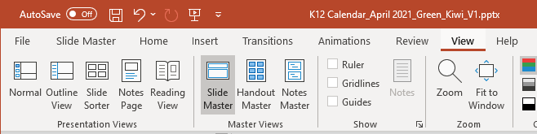
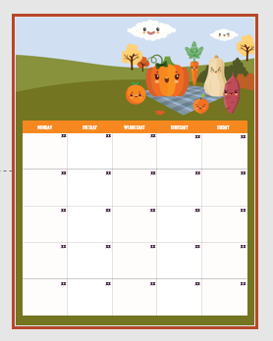
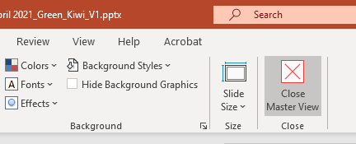
DIRECTIONS FOR EDITING CALENDAR
Click on the Slide Master found in the View tab
Select the Master Slide with the calendar
Double Click in each cell to edit date
HINT: Hit Tab to advance cell to cell
Close Master View (found in header/ribbon)
Edit year, Add logo, and populate your menu on Slide 2
Work with local vendor for printing

Slide 2



Gregory
NOVEMBER 2023
All breads are whole grain
All juice is 100% fruit juice
Fresh Fruit & vegetable
served daily
Choice of white or chocolate
milk
Menus are subject to change
ACE Lucky Tray Day
Discovery Day!
Texas Mushrooms
Now Hiring!!
Food Service is Hiring!
Work While Kids are in School
Great Benefits
Apply online @ www.aramark.com
This institution is an equal opportunity provider.

Slide 3


